Slide 1


DARES ELECTRONICS
01
Team structure
02
Flight Control
Week 9 +
mid-sem break
03
Power Systems
04
Propulsion
05
Navigation & Estimation
Avionics + propulsion · Saturday 26 September
06
Potential R&D: Autonomy & ML
07
Teams
08
Over the break

Slide 2

SUB-TEAM | Candidate Leads (open/TBD, according to performance) | MEMBERS (Encouraged Flexibility)
Flight Control | Rohan Lynch Ash Zhang | Rohan Lynch Ash Zhang Nicholas Tran
Power Systems | Alfred Wang Zixi Chen | Zixi Chen Alfred Wang Ash Zhang Wen Ying Gan
Propulsion & Motor Control | Jinghan Li Jayden Filleul Harry Nguyen | Jayden Filleul Jinghan LI Zhen Rong (Drew) Fong Amelia Zhu Jiarong Chen Harry Nguyen Mahin Shams
Sensor Fusion & Navigation | David Shmail | Nicholas Tran Yifei Sun Wenrui Chen Leah Chen Amelia Chen David Shmail
Autonomy & Machine Learning Potential research-style R&D, will confirm with DARES in the coming weeks. Express your interest if you have it | Shangrui Wu David Shmail | Jinghan Li David Shmail Shangrui Wu

Slide 3
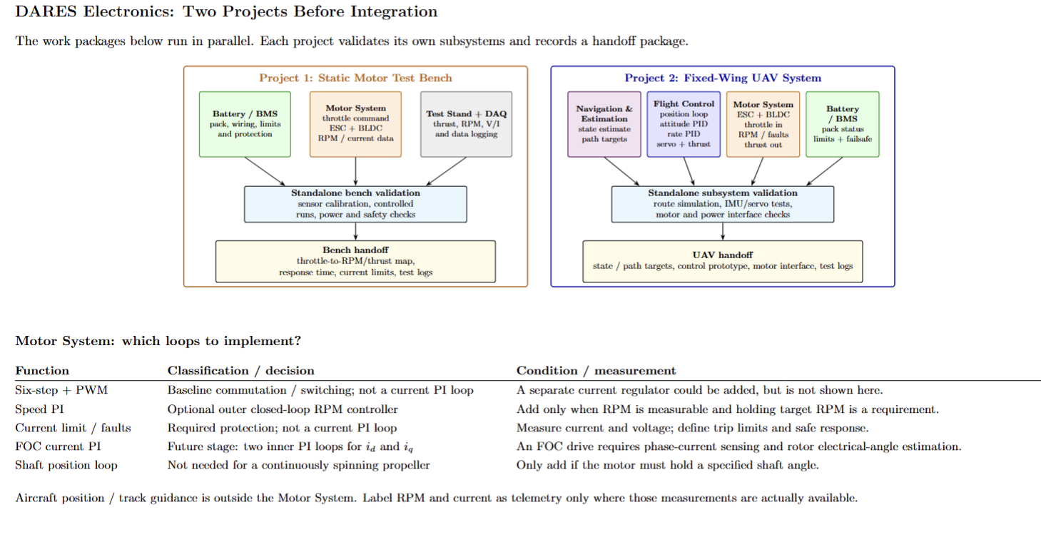
01
Team Workflows
Flight Control
Power Systems
Propulsion & Motor Control
Sensor Fusion & Navigation
→
2 projects
READ:
These are our two workflows: each sub-system is built and tested independently on a test bench or in simulation. Project 1 does this for the propulsion chain, and Project 2 brings every validated piece together into the aircraft, one interface at a time.
Diagrams: Jinghan Li

Slide 4
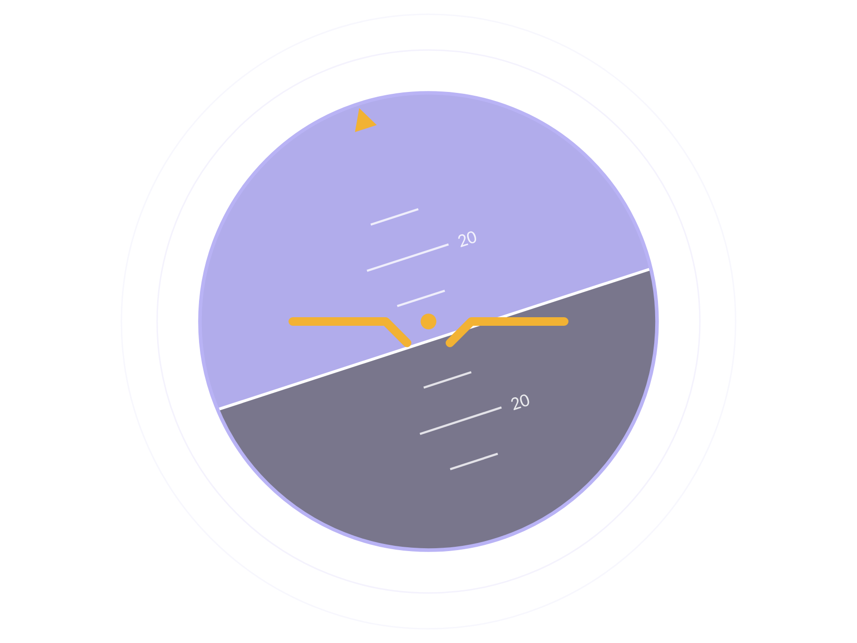
DARES ELECTRONICS
02
Flight Control
Rohan Lynch + Ash Zhang

Slide 5
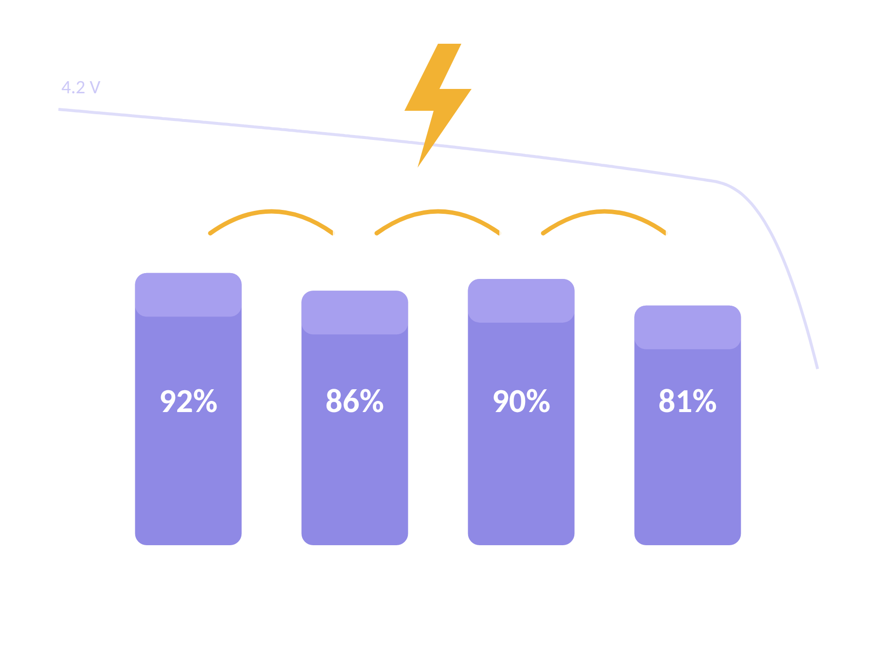
DARES ELECTRONICS
03
Power Systems
Alfred Wang

Slide 6
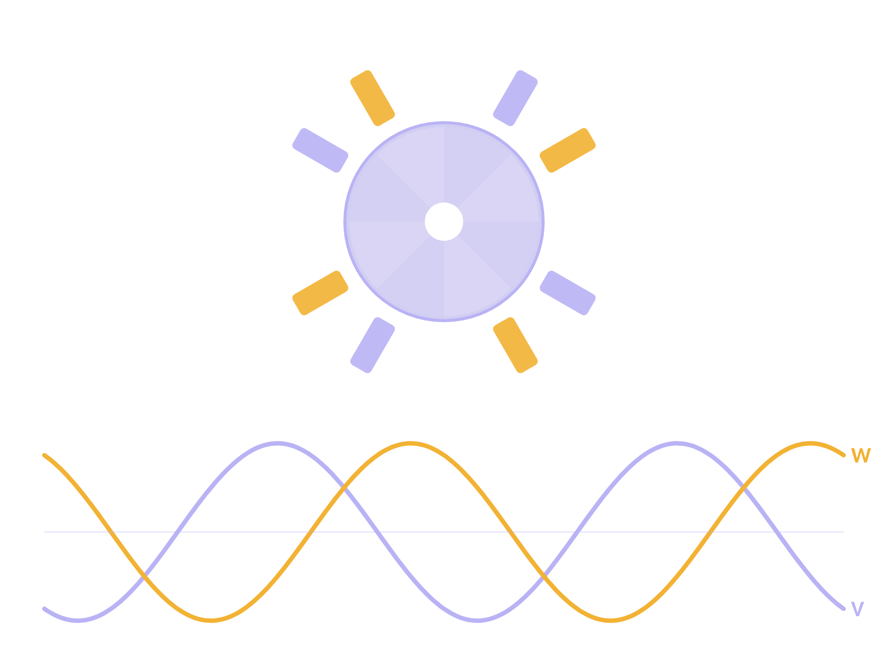
DARES ELECTRONICS
04
Propulsion & Motor Control
Jinghan Li + Jayden Filleul

Slide 7
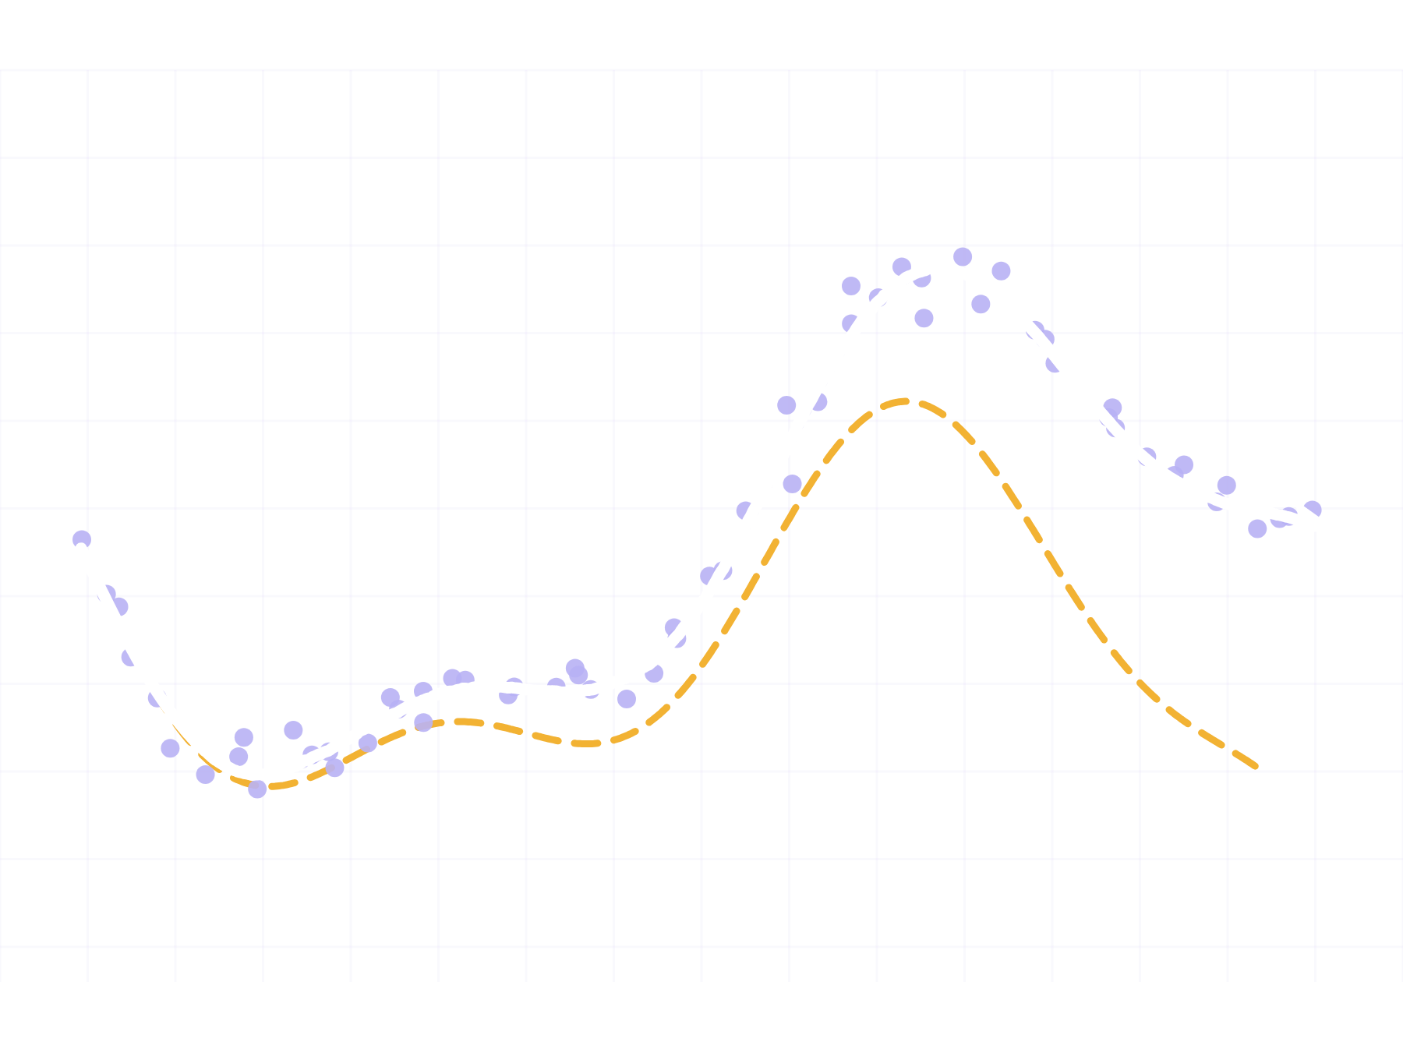
DARES ELECTRONICS
05
Sensor Fusion & Navigation
David Shmail

Slide 8
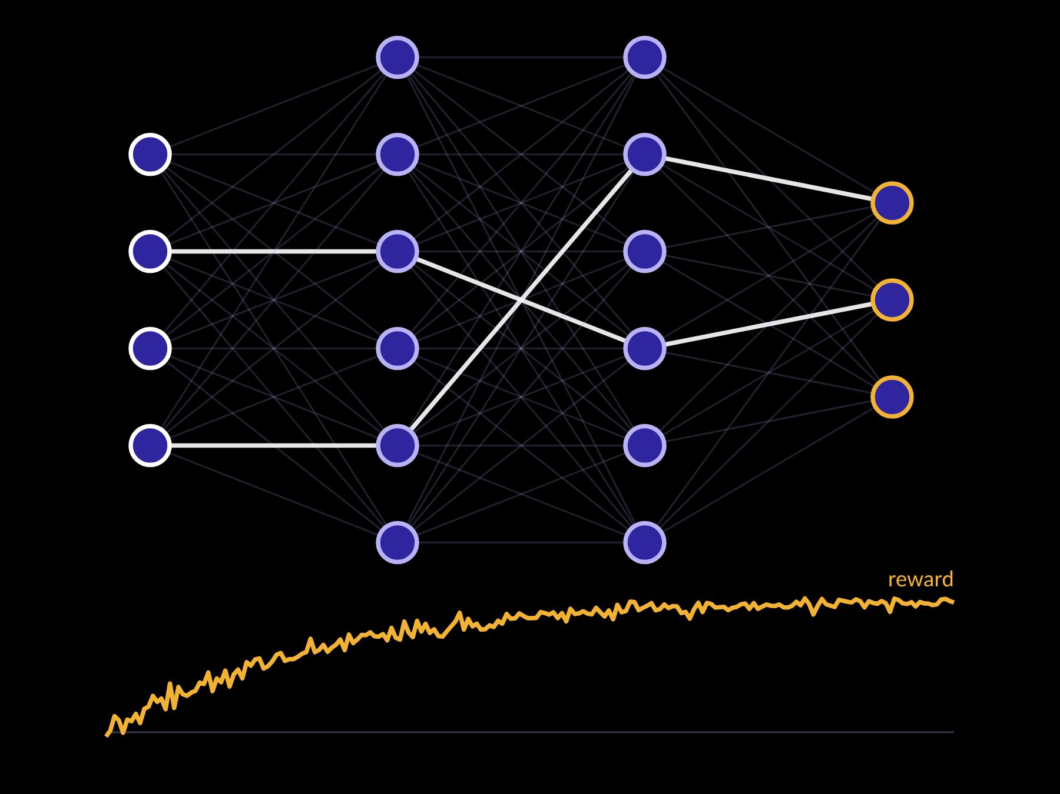
DARES ELECTRONICS
06
Autonomy
& Machine Learning
Shangrui Wu, David Shmail
POTENTIAL R&D · NOT YET FORMALISED

Slide 9
DARES ELECTRONICS
08
Over the break
✓
To-do
+
Optional advanced
everyone, in your sub-team document
for those who want more
Why: so we come back ready to design and build, not starting from zero.
IMU + PID workshop: details soon, pending committee approval

